Slide 1
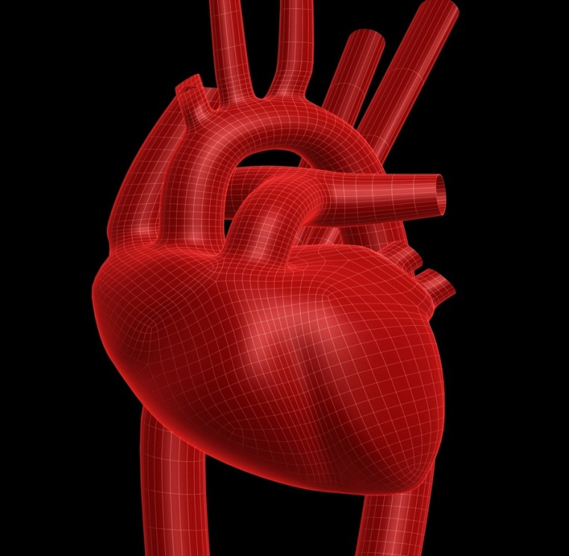
The Heart

Slide 2
Why do we need blood?
Blood carries oxygen, nutrients, and chemical energy from one part of your body to the other. Without blood your brain would never get the oxygen which is produced in your lungs or the chemical energy which is produced in your digestive system, and you would die very quickly.

Slide 3
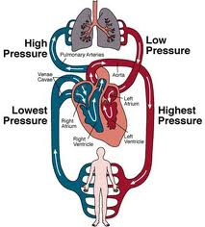
What colour is blood?
Blood without oxygen is blue ,but with oxygen it is red.
When it circles around your body it picks up oxygen from the lungs then goes around your body

Slide 4
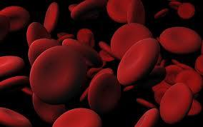
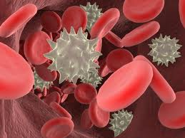
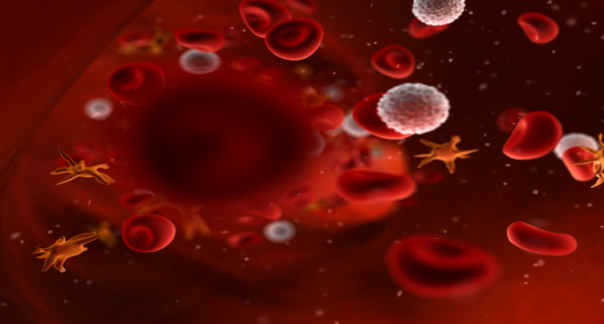
Blood Cells
Red blood cells – Erythrocytes
White blood cells – Leukocytes
Platelets – Thrombocytes.

Slide 5
Gingernut prodution

