Slide 1


Slide 2
Trigonometry
Trigonometry is a branch of Mathematics with several important and useful applications.
Trigonometry is the branch of mathematics which deals with triangles.
Trigonometry is derived from Greek words trigonon (three angles) and metron ( measure).
By Chimin :)

Slide 3
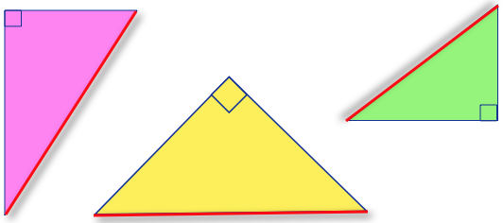
Right-angled triangles

Slide 4
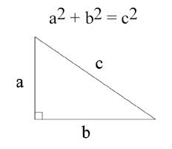
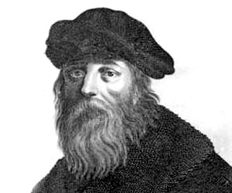
Pythagoras Theorem

Slide 5
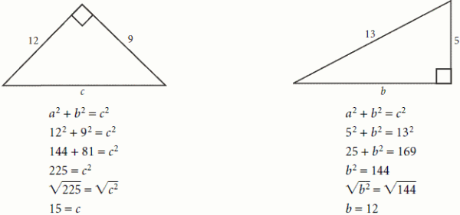
Example

Slide 6
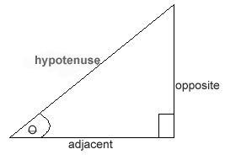
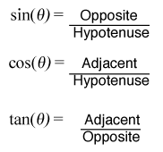
Ratios
*REMEMBER*
SOH. CAH. TOA.
O, Hell, Another
Hour Of Algebra.

Slide 7
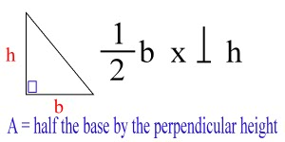
Area of a right-angled triangle

Slide 8


Slide 9
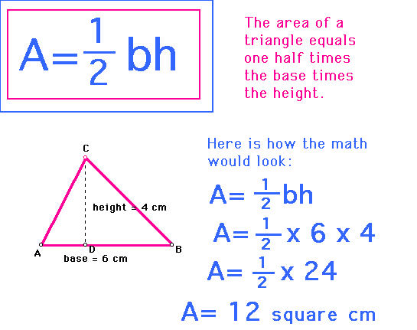
Example

Slide 10
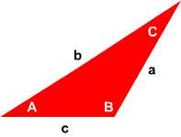
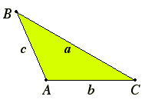
Non-right-angled triangles

Slide 11
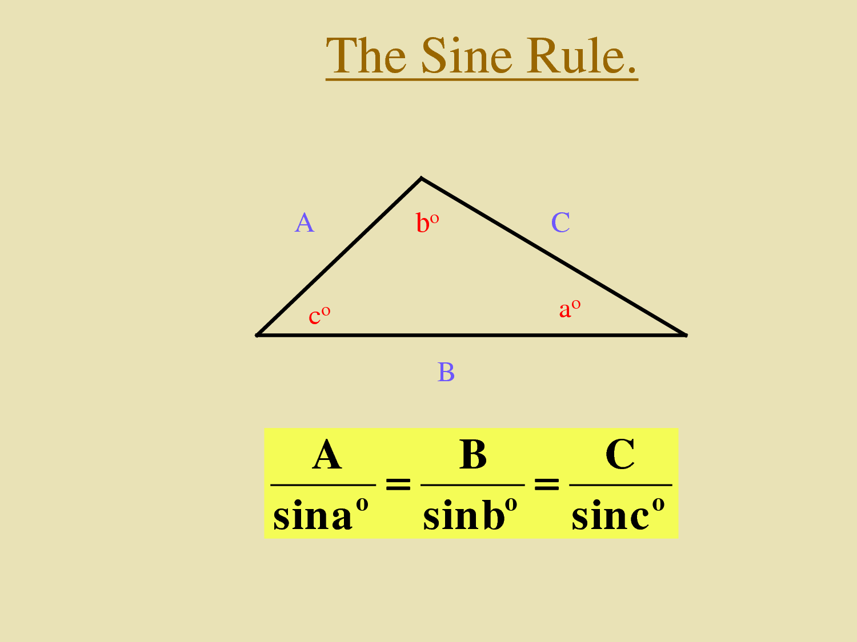

Slide 12
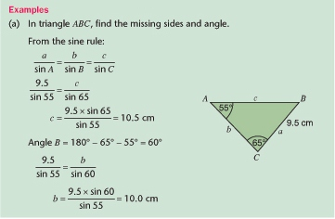

Slide 13
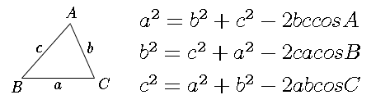
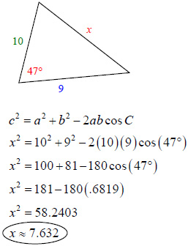
Cosine Rule
Example

Slide 14
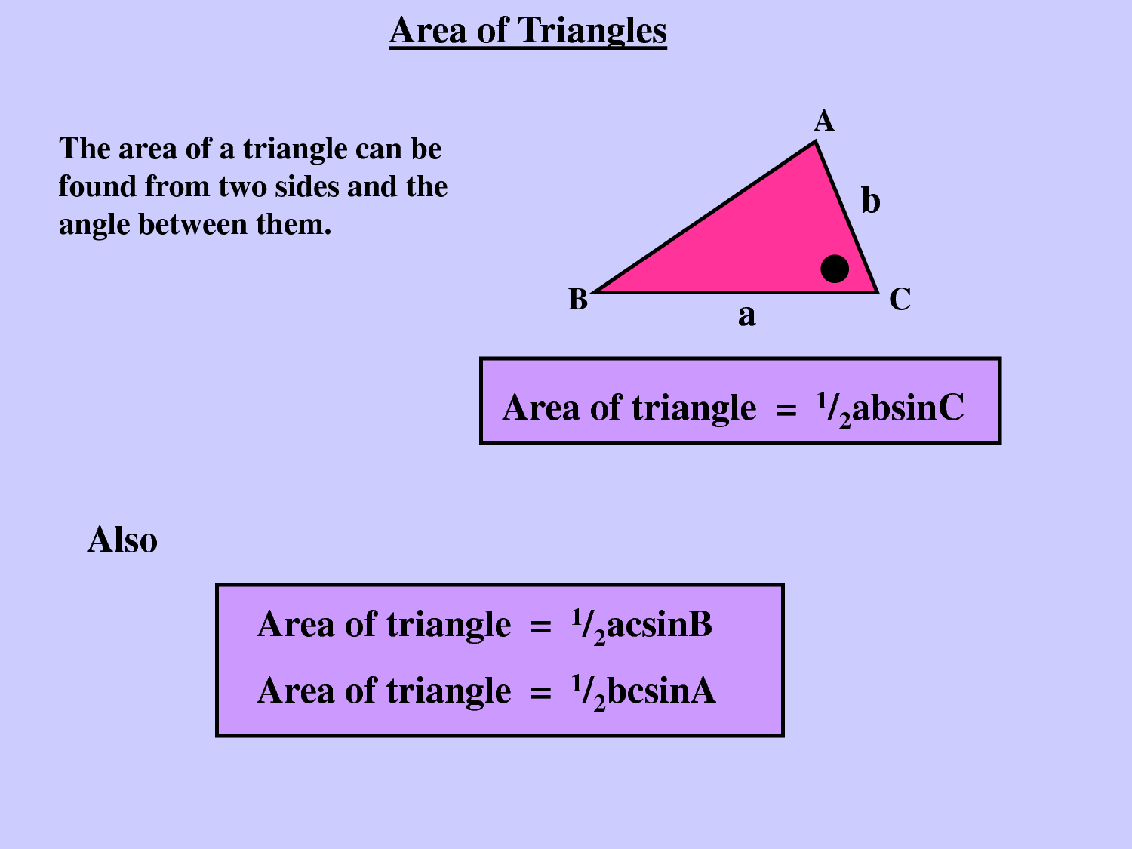

Slide 15
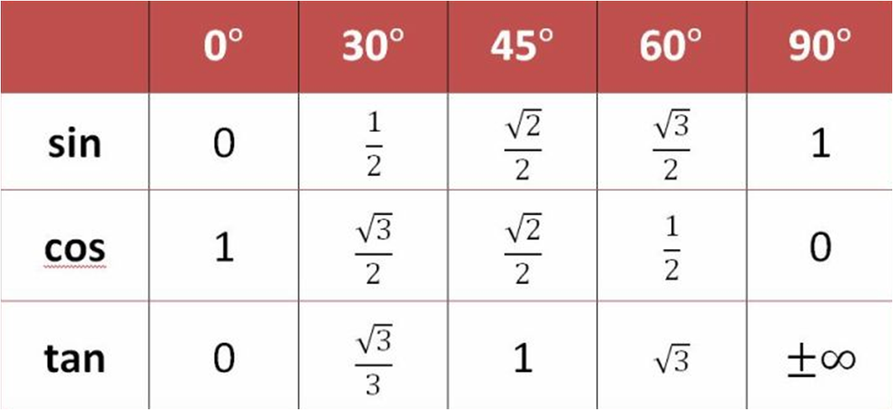
Special angles

Slide 16
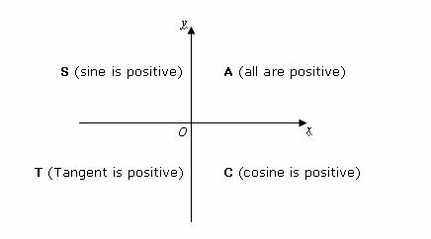
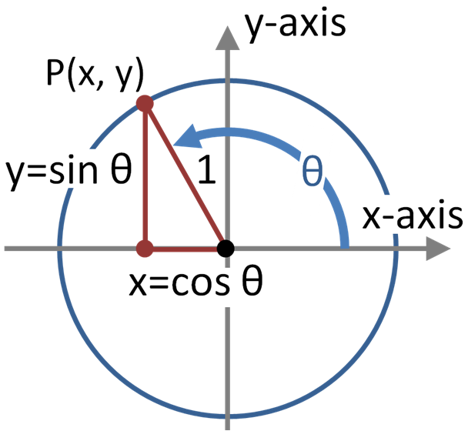
Unit Circle
*Remember*
CAST!

Slide 17
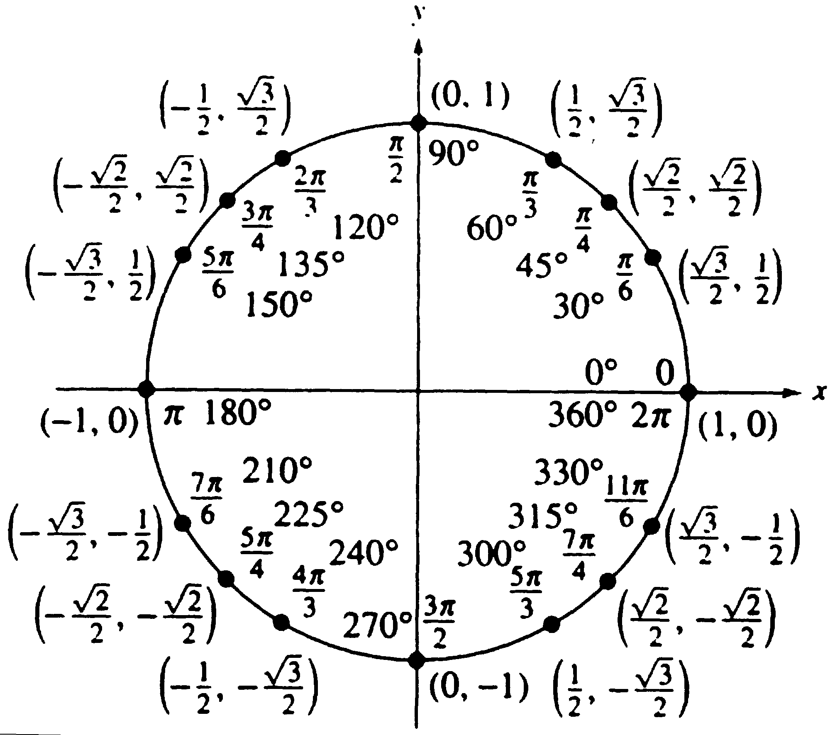

Slide 18


Slide 19
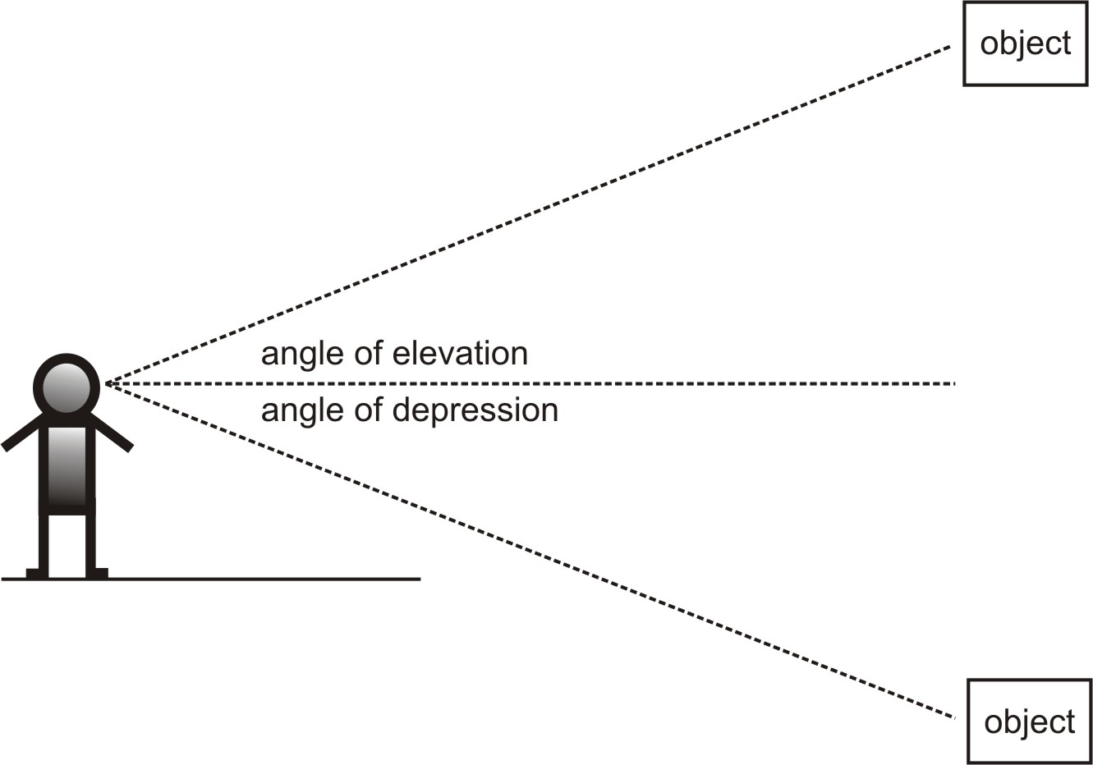
Angles of Elevation and Depression
Angle of Elevation:The angle through which our eyes move upwards to see an object above us.
Angle of depression:The angle through which our eyes move downwards to see an object below us.

Slide 20


